Slide 1
HOME AUTOMATION USING HC-05 AND ARDUINO UNO

Slide 2
INTRODUCTION
Arduino Microcontrollers are becoming famous these days due to their ease of use and vast application areas such as Automation, Robotics, Iot, Embedded systems, Weather and Agriculture applications (for smart irrigation systems) and many more. Its cheap and easy to program which is why these are best for newbies especially who want to learn and pursue their career in microcontroller and embedded design fields. Their easy interfacing with sensors and actuators is one of the attracting features.

Slide 3
ABSTRACT:
The main objective of this project is to develop a home automation system using an Arduino board with Bluetooth being voice controlled by any Android OS smart phone. As technology is advancing so houses are also getting smarter.
Modern houses are gradually shifting from conventional switches to centralized control system, involving voice controlled switches. Presently, conventional wall switches located in different parts of the house makes it difficult for the user to go near them to operate. Even more it becomes more difficult for the elderly or physically handicapped people to do so. Remote or voice controlled home automation system provides a most modern solution with smart phones.

Slide 4
In order to achieve this, a Bluetooth module is interfaced to the Arduino board at the receiver end while on the transmitter end, a GUI application on the cell phone sends ON/OFF commands to the receiver where loads are connected. By speaking the specified commands on the GUI, the loads can be turned ON/OFF remotely through this technology.

Slide 5
HARDWARE REQUIRED:
HC-05
ARDUINO UNO
CONNECTING WIRES
LED’S

Slide 6
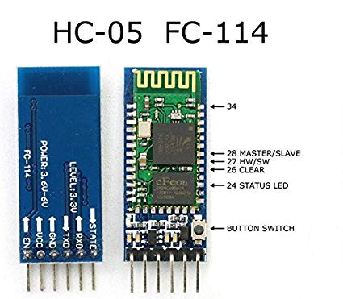
HC-05
HC-05 module is an easy to use Bluetooth SPP (Serial Port Protocol) module, designed for transparent wireless serial connection setup.
Serial port Bluetooth module is fully qualified Bluetooth V2.0+EDR (Enhanced Data Rate) 3Mbps Modulation with complete 2.4GHz radio transceiver and baseband. It uses CSR Blue core 04-External single chip Bluetooth system with CMOS technology and with AFH (Adaptive Frequency Hopping Feature). It has the footprint as small as 12.7mmx27mm. Hope it will simplify your overall design/development cycle.

Slide 7
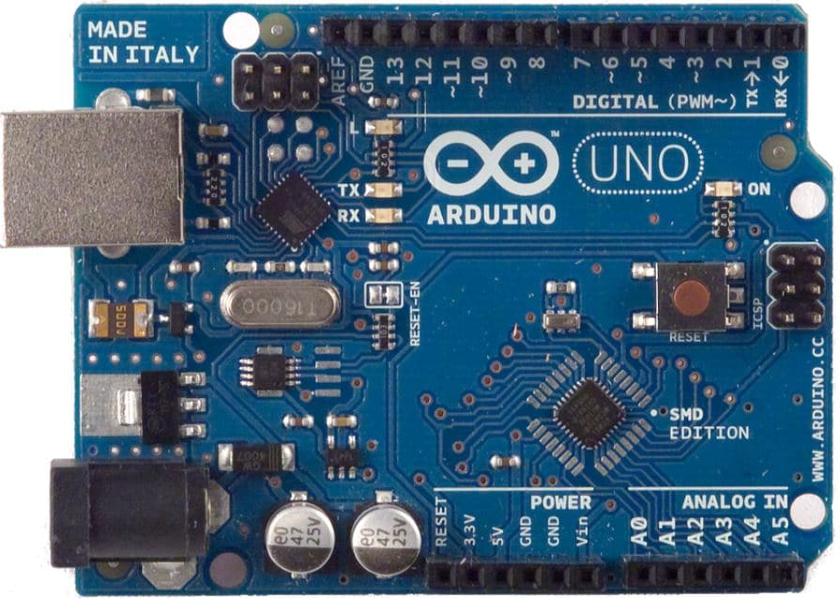
ARDUINO UNO
The Arduino Uno is a microcontroller board based on the ATmega328P. It has 14 digital input/output pins (of which 6 can be used as PWM outputs), 6 analog inputs, a 16 MHz crystal oscillator, a USB connection, a power jack, an ICSP header, and a reset button. It contains everything needed to support the microcontroller; simply connect it to a computer with a USB cable or power it with a AC-to-DC adapter or battery to get started. The Uno differs from all preceding boards in that it does not use the FTDI USB-to serial driver chip. Instead, it features the Atmega8U2 programmed as a USB-to serial converter.

Slide 8
SOFTWARE REQUIRED:
ARDUINO IDE
MIT APP INVENTOR 2

Slide 9
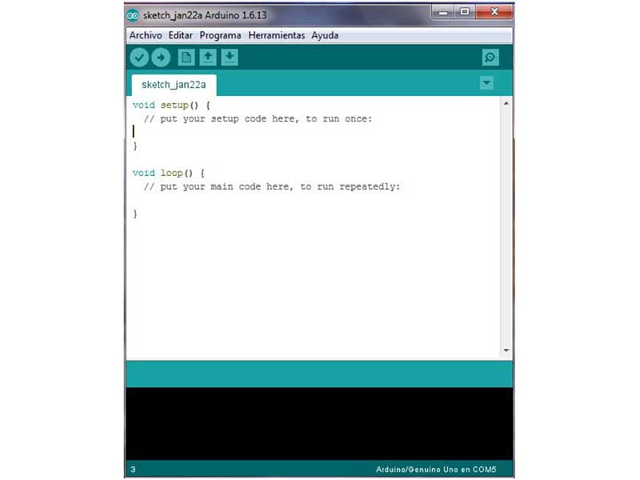
ARDUINO IDE
The Arduino integrated development environment (IDE) is a cross-platform application (for Windows, macOS, Linux) that is written in the programming language Java. It is used to write and upload programs to Arduino compatible boards, but also, with the help of 3rd party cores, other vendor development boards.

Slide 10

MIT APP INVENTOR 2
App Inventor for Android is an open-source web application originally provided by Google, and now maintained by the Massachusetts Institute of Technology (MIT), which allows newcomers to computer programming to create software applications for the Android operating system (OS).

Slide 11
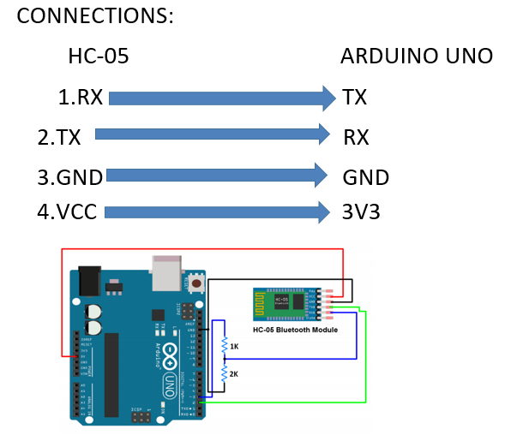
CONNECTIONS

Slide 12
DESCRIPTION
This project is one of the important Arduino Projects. Arduino based home automation using Bluetooth project helps the user to control any electronic device using Device Control app on their Android Smartphone. The android app sends commands to the controller – Arduino, through wireless communication, namely, Bluetooth
The Arduino is connected to the basic shield which has eight led’s. let us consider these eight led’s as different electronic devices.For our convenience let us consider, Device 1 – LED, Device 2- Fan, Device 3 – Lights.

Slide 13
When the user speakes ‘led on’ in the app then the Buzzer is switched on
When the user speakes ‘led off’ in the app then the Buzzer is switched off
When the user speakes ‘fan on’ in the app then the fan is switched on
When the user speakes ‘fan off’ in the app then the fan is switched off
When the user speakes ‘light on’ in the app then the light is switched on
When the user speakes ‘light off’ in the app then the light is switched
Off
When the user speakes ‘all on’ In the app then the electronic device is switched on
When the user speakes ‘all off’ in the app then the electronic device is switched Off

Slide 14
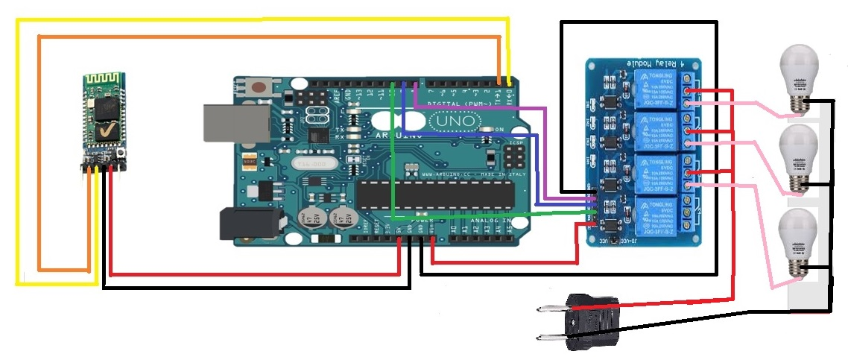
BLOCK DIAGRAM:

Slide 15
ADVANTAGES
Can be used by physically challenged and disabled people
Quick response is achieved.
Easy to maintain and repair.
Design is efficient and low cost.
Power consumption is low.
Controlling electrical devices wirelessly
Saves electricity.
We can control appliances from any place round the room

Slide 16
DISADVANTAGES
Only works for limited range or short distance within 5-10m surroundings.
No feedback path available.
Number of appliances which can be controlled through this circuit are limited.
Circuit complexity increases as number of devices increase’

Slide 17
CONCLUSION
The home automation system has been experimentally proven to work satisfactorily by connecting sample appliances to it and the appliances were successfully controlled from a wireless mobile device
The Bluetooth client was successfully tested on a multitude of different mobile phones from different manufacturers, thus proving its portability and wide compatibility. Thus a low-cost home automation system was successfully designed, implemented and tested.

Slide 18
THANK YOU

